Slide 1
Introduction to Flutter Widgets

Slide 2
Widgets
In Flutter, Everything is a widget.
In Flutter, the application is itself a widget
The application is the top- level widget and its UI is build using one or more children (widgets), which again build using its children widgets.
This composability feature helps us to create a user interface of any complexity.

Slide 3
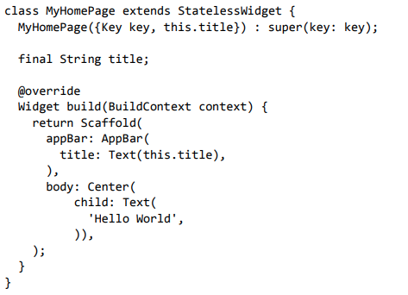
Sample Hello World Program
Notes:
Important Points
StatelessWidget only requires a single method build to be implemented in its derived class
The build method gets the context environment necessary to build the widgets through BuildContext parameter and returns the widget it builds
In the code, we have used title as one of the constructor argument and also used Key as another argument. The title is used to display the title and Key is used to identify the widget in the build environment.
Here, the build method calls the build method of Scaffold, which in turn calls the build method of AppBar and Center to build its user interface.

Slide 4
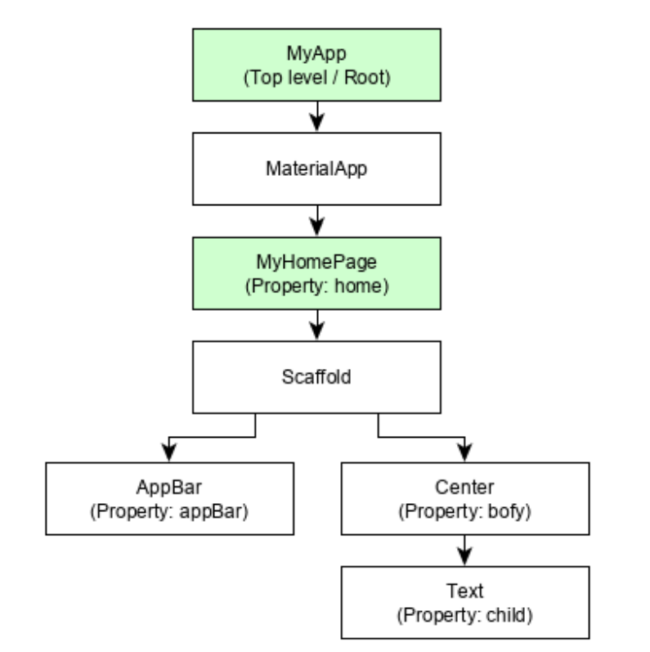
Widget Hierarchy of Hello World Program
Notes:
• MyApp is the user created widget and it is build using the Flutter native widget, MaterialApp.
• MaterialApp has a home property to specify the user interface of the home page, which is again a user created widget, MyHomePage.
• MyHomePage is build using another flutter native widget, Scaffold.
• Scaffold has two properties – body and appBar.
• body is used to specify its main user interface and appBar is used to specify its header user interface.
• Header UI is build using flutter native widget, AppBar and Body UI is build using Center widget.
• The Center widget has a property, Child, which refers the actual content and it is build using Text widget.

Slide 5
Concept of State
Flutter widgets support State maintenance by providing a special widget, StatefulWidget.
Widget needs to be derived from StatefulWidget widget to support state maintenance and all other widget should be derived from StatelessWidget.
StatefulWidget will be auto re- rendered whenever its internal state is changed

Slide 6
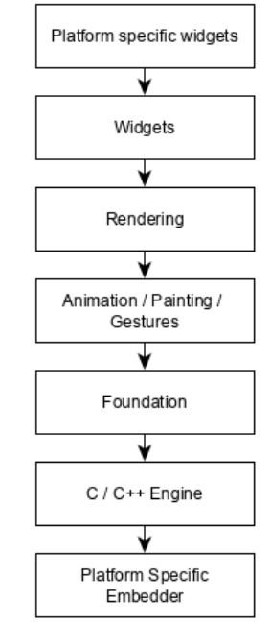
Layers
Notes:
Summary
• In Flutter, everything is a widget and a complex widget is composed of already existing widgets.
• Interactive features can be incorporated whenever necessary using GestureDetector widget.
• The state of a widget can be maintained whenever necessary using StatefulWidget widget.
• Flutter offers layered design so that any layer can be programmed depending on the complexity of the task

Slide 7
Widget Build Visualization
In Flutter, widgets can be grouped into multiple categories based on their features, as listed below:
Platform specific widgets
Layout widgets
State maintenance widgets
Platform independent / basic widgets

Slide 8
Platform specific widgets
Flutter has widgets specific to a particular platform - Android or iOS
Android specific widgets are designed in accordance with Material design guideline by Android OS. Android specific widgets are called as Material widgets.
iOS specific widgets are designed in accordance with Human Interface Guidelines by Apple and they are called as Cupertino widgets.
Note: Android and iOS specific widgets are given in notes.
Notes:
Some of the most used material widgets are as follows: (Android)
Scaffold
AppBar
BottomNavigationBar
TabBar
TabBarView
ListTile
RaisedButton
FloatingActionButton
FlatButton
IconButton
DropdownButton
PopupMenuButton
ButtonBar
TextField
Checkbox
Radio
Switch
Slider
Date & Time Pickers
SimpleDialog
AlertDialog
Some of the most used Cuppertino widgets are as follows: (iOS)
CupertinoButton
CupertinoPicker
CupertinoDatePicker
CupertinoTimerPicker
CupertinoNavigationBar
CupertinoTabBar
CupertinoTabScaffold
CupertinoTabView
CupertinoTextField
CupertinoDialog
CupertinoDialogAction
CupertinoFullscreenDialogTransition
CupertinoPageScaffold
CupertinoPageTransition
CupertinoActionSheet
CupertinoActivityIndicator
CupertinoAlertDialog
CupertinoPopupSurface

Slide 9
Layout widgets
In Flutter, a widget can be created by composing one or more widgets
Some of the popular layout widgets are as follows:
Container: A rectangular box decorated using BoxDecoration widgets with background, border and shadow.
Center: Center its child widget
Row: Arrange its children in the horizontal direction.
Column: Arrange its children in the vertical direction.
Stack: Arrange one above the another.

Slide 10
State maintenance widgets
In Flutter, all widgets are either derived from StatelessWidget or StatefulWidget.
Widget derived from StatelessWidget does not have any state information but it may contain widget derived from StatefulWidget.

Slide 11
Platform independent / basic widgets
Flutter provides large number of basic widgets to create simple as well as complex user interface in a platform independent manner.
Text
Image
Icon
etc

Slide 12
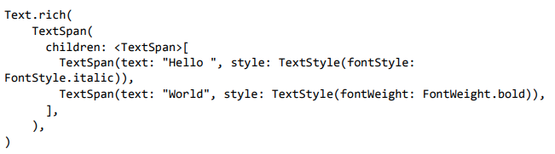
Text Widget
Text widget is used to display a piece of string. The style of the string can be set by using style property and TextStyle class. The sample code for this purpose is as follows:
Text widget has a special constructor, Text.rich, which accepts the child of type TextSpan to specify the string with different style.
Notes:
The most important properties of the Text widget are as follows:
• maxLines, int: Maximum number of lines to show
• overflow, TextOverFlow: Specify how visual overflow is handled using TextOverFlow class
• style, TextStyle: Specify the style of the string using TextStyle class
• textAlign, TextAlign: Alignment of the text like right, left, justify, etc., using TextAlign class
• textDirection, TextDirection: Direction of text to flow, either left-to-right or rightto-left

Slide 13
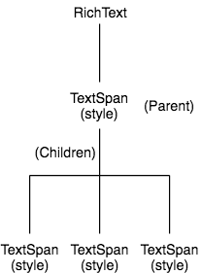
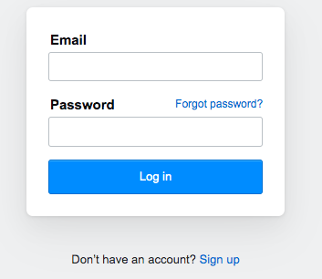
RichText - Example
Hierarchy

Slide 14
Image Widget
Image widget is used to display an image in the application.
Image widget provides different constructors to load images from multiple sources and they are as follows:
Image - Generic image loader using ImageProvider
Image.asset - Load image from flutter project’s assets
Image.file - Load image from system folder
Image.memory - Load image from memory
Image.Network - Load image from network

Slide 15

Image Widget (contd…)
The easiest option to load and display an image in Flutter is by including the image as assets of the application and load it into the widget on demand.
Create a folder, assets in the project folder and place the necessary images.
Specify the assets in the pubspec.yaml as shown below:
Now, load and display the image in the application.
Notes:
The most important properties of the Image widget are as follows:
• image, ImageProvider: Actual image to load
• width, double - Width of the image
• height, double - Height of the image
• alignment, AlignmentGeometry - How to align the image within its bounds

Slide 16
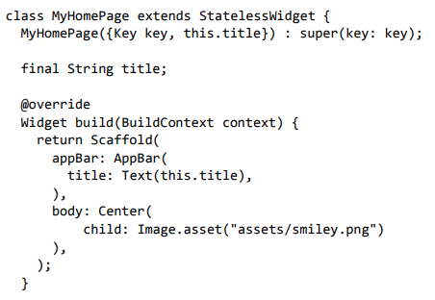
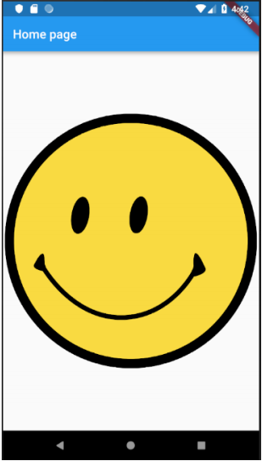
Sample complete code to show image

Slide 17
Icon Widget
Icon widget is used to display a glyph from a font described in IconData class.
The code to load a simple email icon is as follows:

Slide 18
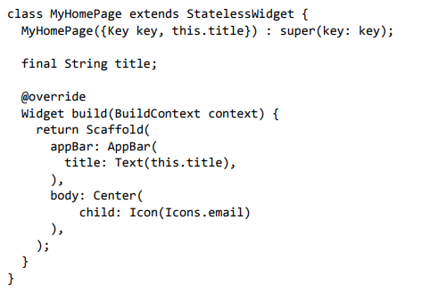
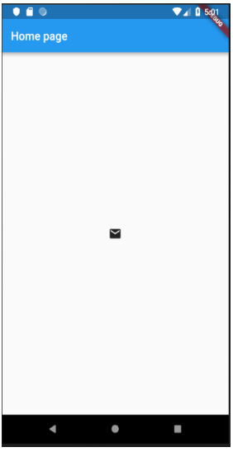
Sample complete code to show Icon

Slide 19
Introduction to Flutter layouting

Slide 20
Layout Widgets
Layout widgets can be grouped into two distinct category based on its child:
Widget supporting a single child
Widget supporting multiple child

Slide 21
Single Child Widgets
In this category, widgets will have only one widget as its child and every widget will have a special layout functionality.
For example, Center widget just centers it child widget with respect to its parent widget and Container widget provides complete flexibility to place it child at any given place inside it using different option like padding, decoration, etc.
Single child widgets are great options to create high quality widget having single functionality such as button, label, etc.,

Slide 22
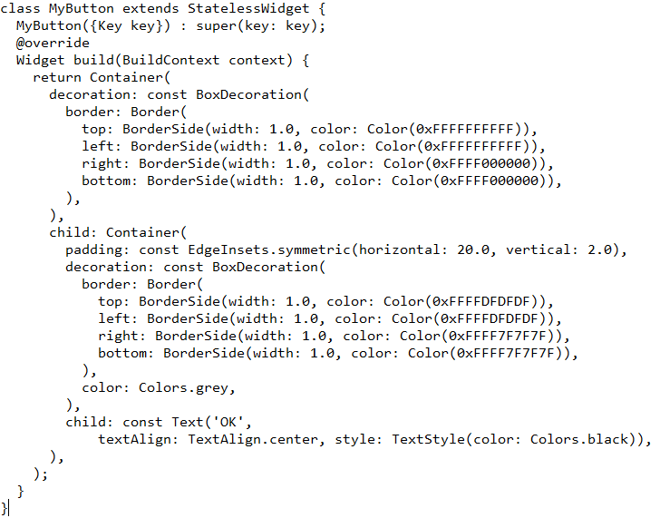
Sample code to create single child widget

Slide 23
Single Child Widgets (contd…)
Padding: Used to arrange its child widget by the given padding. Here, padding can be provided by EdgeInsets class.
Align: Align its child widget within itself using the value of alignment property. The value for alignment property can be provided by FractionalOffset class.
The FractionalOffset class specifies the offsets in terms of a distance from the top left.
Some of the possible values of offsets are as follows:
FractionalOffset(1.0, 0.0) represents the top right.
FractionalOffset(0.0, 1.0) represents the bottom left.

Slide 24
Single Child Widgets (contd…)
FittedBox: It scales the child widget and then positions it according to the specified fit.
AspectRatio: It attempts to size the child widget to the specified aspect ratio
Notes:
Some more Single Child Widgets
• ConstrainedBox
• Baseline
• FractinallySizedBox
• IntrinsicHeight
• IntrinsicWidth
• LiimitedBox
• OffStage
• OverflowBox
• SizedBox
• SizedOverflowBox
• Transform
• CustomSingleChildLayout

Slide 25
Multiple Child Widgets
In this category, a given widget will have more than one child widgets and the layout of each widget is unique.
Row - Allows to arrange its children in a horizontal manner.
Column - Allows to arrange its children in a vertical manner.
ListView - Allows to arrange its children as list.
GridView - Allows to arrange its children as gallery.
Expanded - Used to make the children of Row and Column widget to occupy the maximum possible area.
Table - Table based widget.
Flow - Flow based widget.
Stack - Stack based widget

Slide 26
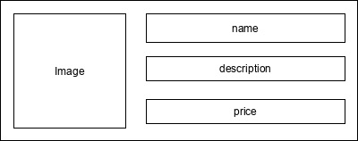
Advanced Layouting
Lets learn how to create advanced layouts.
Open the hello world application code.
Now, create a new widget, ProductBox according to the specified design as shown below

Slide 27
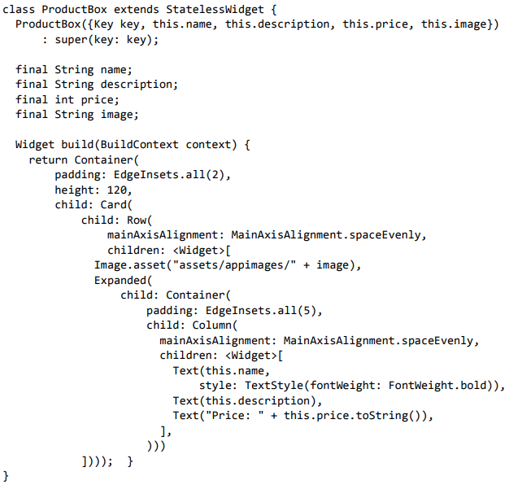
ProductBox widget code
Notes:
Observations: Please observe the following in the code:
• ProductBox has used four arguments as specified below:
o name - Product name
o description - Product description
o price - Price of the product
o image - Image of the product
• ProductBox uses seven build-in widgets as specified below:
o Container
o Expanded
o Row
o Column
o Card
o Text
o Image
Code:
class ProductBox extends StatelessWidget { ProductBox({Key key, this.name, this.description, this.price, this.image}) : super(key: key); final String name; final String description; final int price; final String image; Widget build(BuildContext context) { return Container( padding: EdgeInsets.all(2), height: 120, child: Card( child: Row( mainAxisAlignment: MainAxisAlignment.spaceEvenly, children: [ Image.asset("assets/appimages/" + image), Expanded( child: Container( padding: EdgeInsets.all(5), child: Column( mainAxisAlignment: MainAxisAlignment.spaceEvenly, children: [ Text(this.name, style: TextStyle(fontWeight: FontWeight.bold)), Text(this.description), Text("Price: " + this.price.toString()), ], ))) ]))); } }

Slide 28
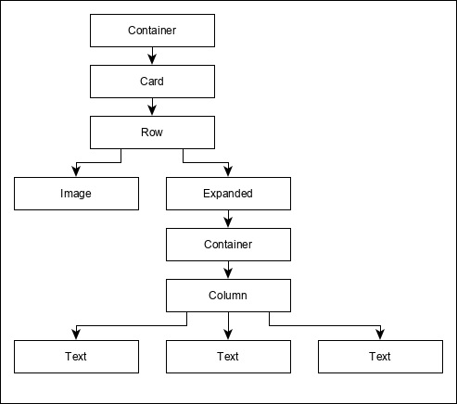
ProductBox widget
The arrangement or hierarchy of the widget is specified in the diagram shown below:

Slide 29
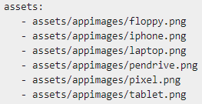
ProductBox widget (contd…)
Now, place some dummy image (see below) for product information in the assets folder of the application and configure the assets folder in the pubspec.yaml file as shown below −

Slide 30
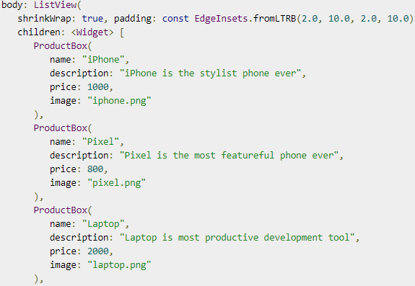
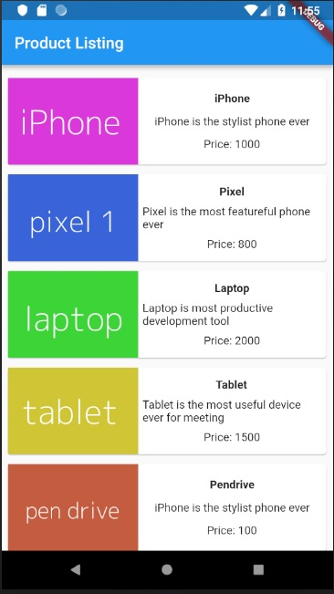
ProductBox widget (contd…)
Finally use the ProductBox widget in already completed code.
Notes:
With shrinkWrap: true, you can change this behavior so that the ListView only occupies the space it needs

Slide 31
Gestures
Flutter widgets support interaction through a special widget, GestureDetector.
GestureDetector is an invisible widget having the ability to capture user interactions such as tapping, dragging, etc., of its child widgets.

